Slide 1
Honors 9th Literature
Vocabulary Unit 4

Slide 2
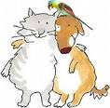
Affable (adj.)
courteous
pleasant
sociable
cordial
-------------------------
surly
cantankerous
inhospitable

Slide 3
Aggrandize (v.)
to increase in greatness, power, and wealth
to make appear greater/grander
amplify
exalt
--------------------------------
decrease
diminish

Slide 4
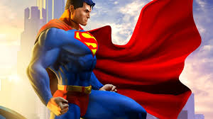
Archetype (n.)
A prototype
An original model
An ideal example of a person/thing

Slide 5
Aura (n.)
a distinctive air or personal quality
an atmosphere
ambience
atmosphere

Slide 6
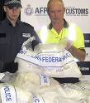
Contraband (n.)
illegal traffic
smuggled goods
illegal
prohibited
illicit
unlawful
--------------------------------
legal
lawful

Slide 7
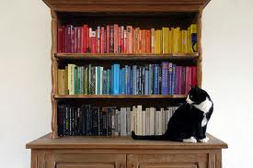
Erudite (adj.)
Scholarly
Learned
Bookish

Slide 8
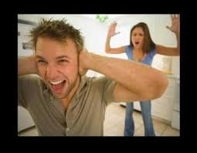
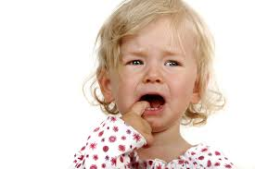
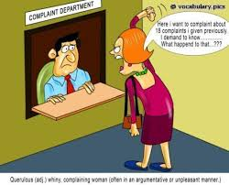
Querulous (adj.)
complaining
peevish
fretful
cranky
irritable
--------------------------------
uncomplaining
serene

Slide 9
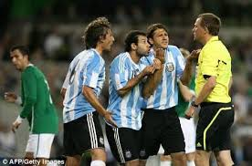
Remonstrate (v.)
To argue with someone;
to protest

Slide 10
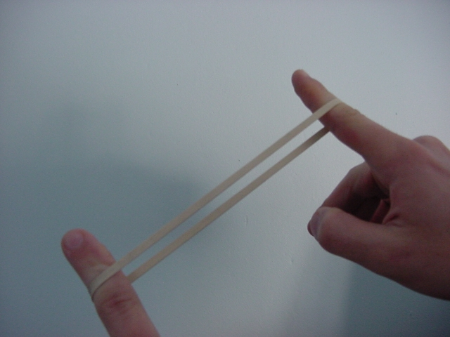
Resilient (adj.)
able to return to an original shape or form
able to recover quickly
----------------------------
rigid
inflexible
unyielding

Slide 11
Scurrilous (adj.)
vulgar or low (especially in language)
foul-mouthed
obscene
filthy
--------------------------------
tasteful
dignified

Slide 12
Sedulous (adj.)
Persistent
Showing industry and determination

Slide 13
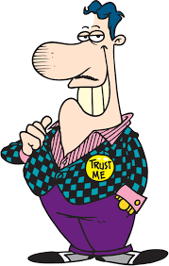
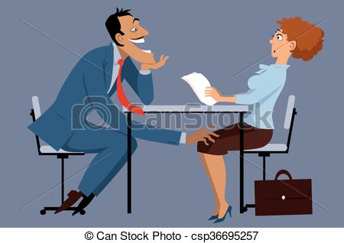
Sleazy (adj.)
Thin or flimsy in texture
Cheap
Ethically low
Inferior
Cheesy

