Slide 1
American Literature
Vocabulary
Unit 15
12 Terms

Slide 2
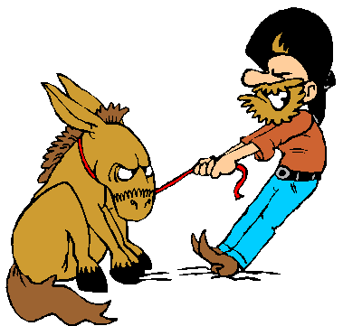
Adamant (AdJ.)
unyielding
firm in purpose or opinion
obdurate
inflexible
----------------
yielding

Slide 3
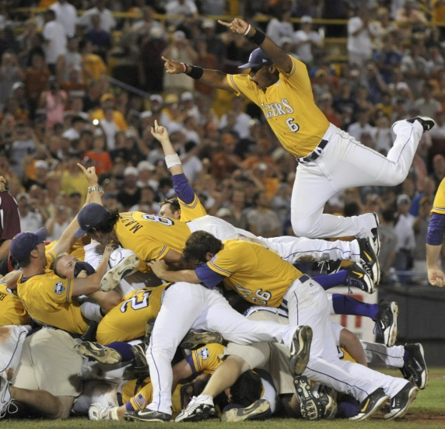
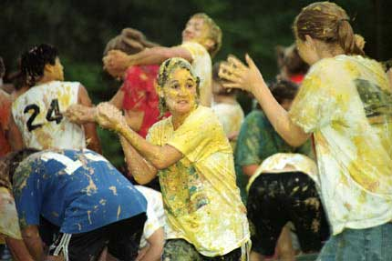
Brouhaha (n.)
a confused hodgepodge of sounds
an uproar or commotion
tumult
pandemonium

Slide 4
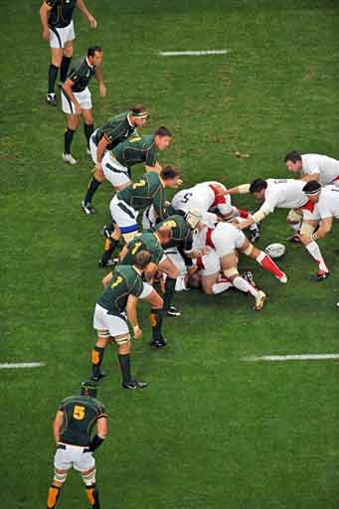
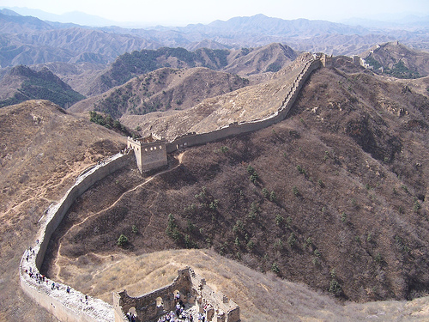
Bulwark (n.)
a strong defense or protection
a solid wall-like structure for defense

Slide 5
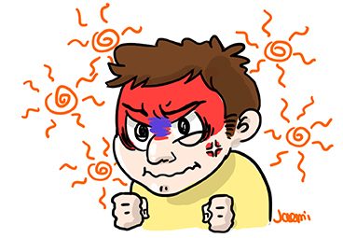
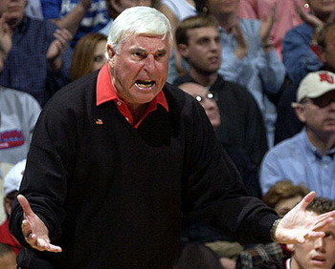
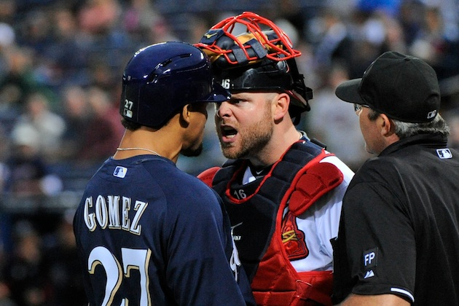
choleric (adj.)
easily made angry
bad-tempered
testy
-----------------
even-tempered

Slide 6
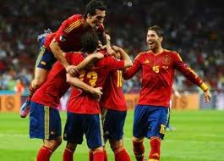
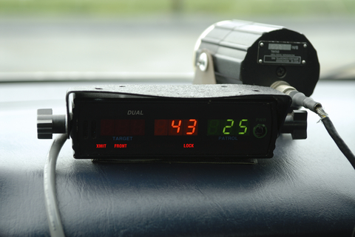
Definitive (adj.)
conclusive
final
the limit of what can be done
exhaustive
authoritative
----------------------
tentative

Slide 7
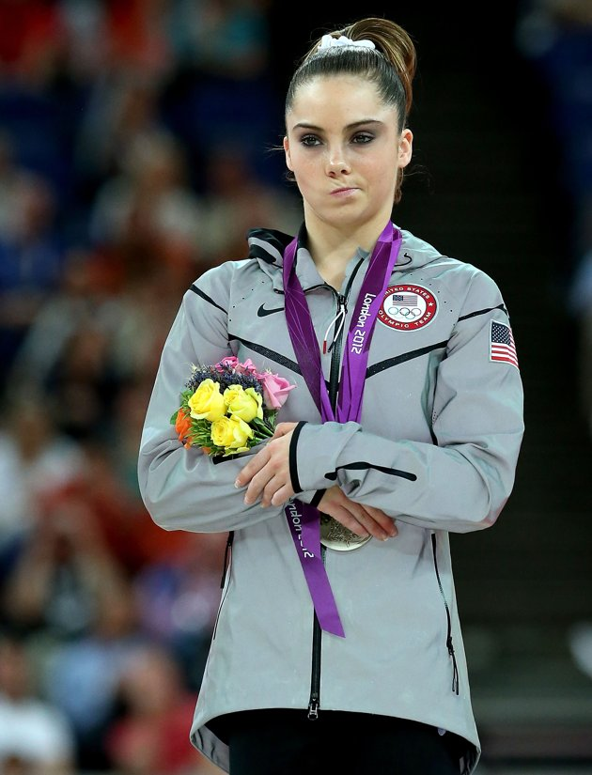
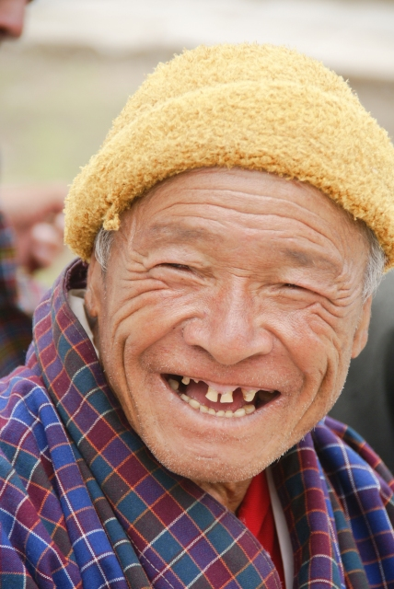
Demeanor (n.)
the way a person behaves
facial appearance
conduct
meaning
carriage

Slide 8
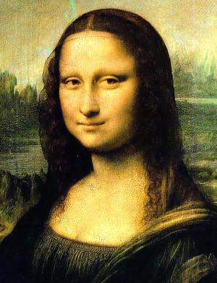
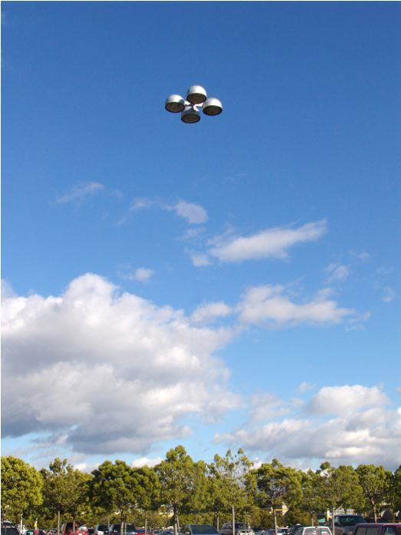
Enigmatic (ADJ.)
puzzling
perplexing
not easily understood
baffling
mysterious
--------------------
understandable

Slide 9
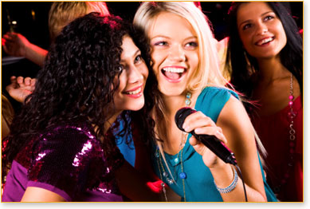
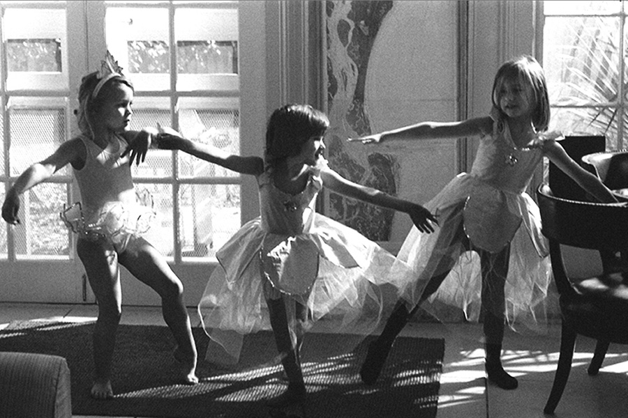
Impromptu (adj., adv.)
without preparation
offhand
spontaneous
unrehearsed
improvised
-----------------------
planned

Slide 10
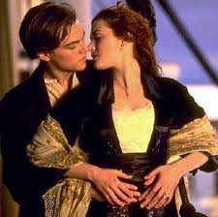
Mawkish(adj.)
excessively and objectionably sentimental
mushy
having a mildly sickening or nauseating flavor

Slide 11
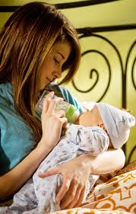
Mollify (v.)
to soften
to calm or allay an emotion
reduce in intensity
placate
pacify
------------------------
aggravate

Slide 12
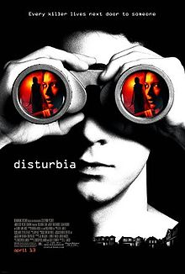
Presentiment (n.)
a vague sense of approaching misfortune
foreboding
hunch
premonition

Slide 13
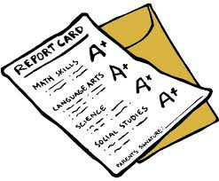
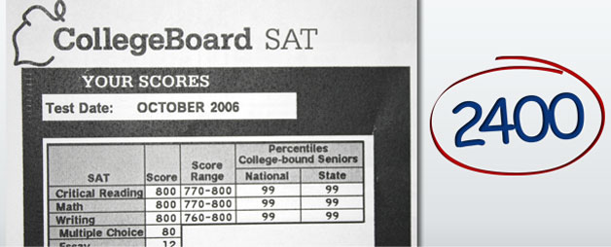
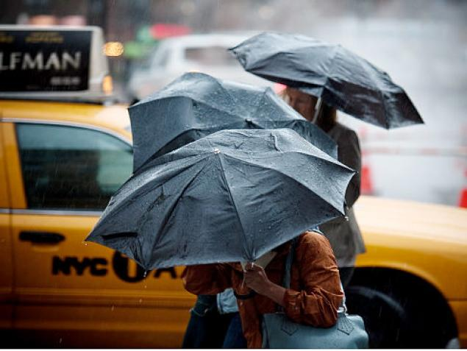
Requisite(adj.)
needed
necessary
indispensable
regarded as essential
--------------------------
nonessential

