Slide 1
SAT Vocabulary unit 3
12 terms – honors 9th lit

Slide 2
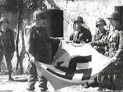
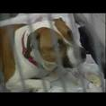
Abominate (v.)
To have an intense dislike or hatred for
loathe
despise
detest
--------------------------------
cherish
esteem

Slide 3
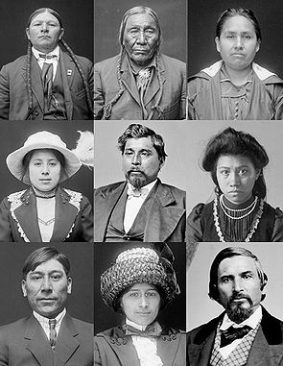
Acculturation (n.)
the modification of the social patterns of one group or society by contact with those of another
blend
adaptation

Slide 4
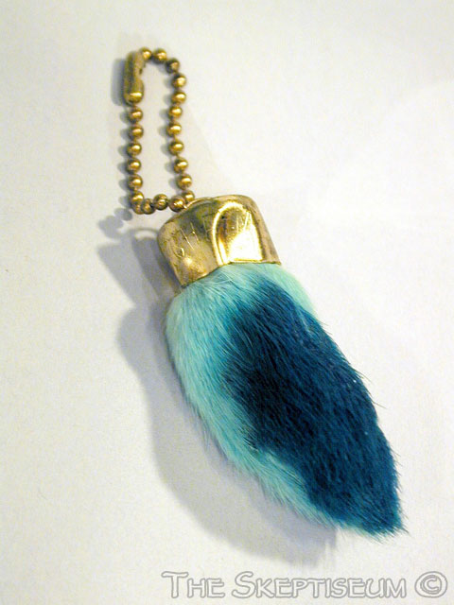
Adventitious (adj.)
resulting from chance rather than from an inherent cause
accidental
incidental
fortuitous
--------------------------------
intrinsic
inherent

Slide 5
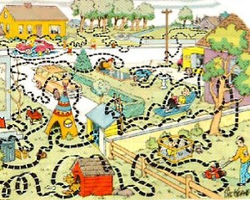
Circuitous (adj.)
roundabout
indirect
meandering
winding
----------------------------
straight
direct

Slide 6
Expedite (v.)
To make easier
To accelerate
To speed up
__________
To hinder
To hamper

Slide 7
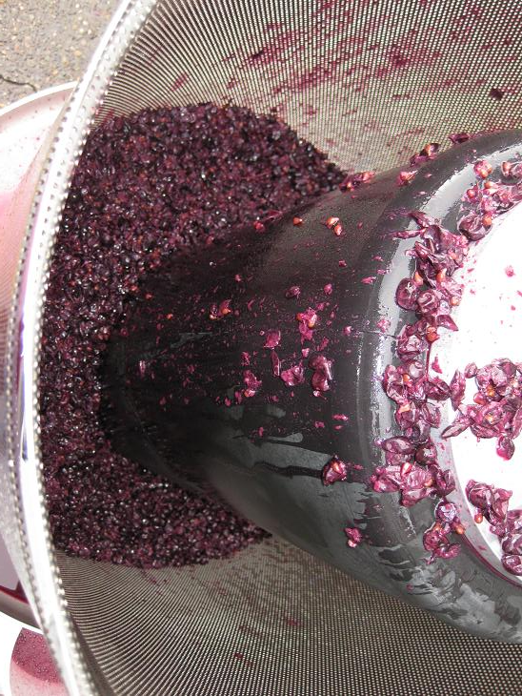
Ferment (n./v.)
a state of great excitement
to produce alcohol by chemical action

Slide 8
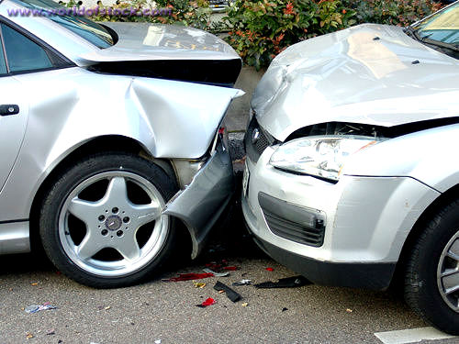
Inadvertent (adj.)
unintentional
accidental
----------------------
deliberate
intentional

Slide 9
Nominal (adj.)
existing in name only
too small to be considered or taken seriously
inconsequential
--------------------------------
real
excessive

Slide 10
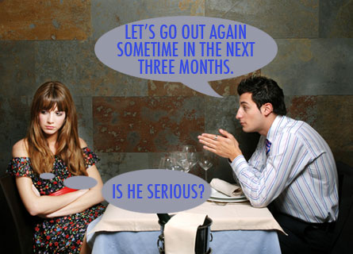
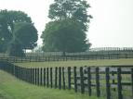
Noncommittal (adj.)
not decisive
not definite
unwilling to take a clear position
playing it safe
--------------------------------
definite
committed

Slide 11
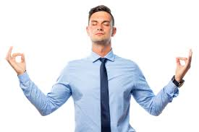
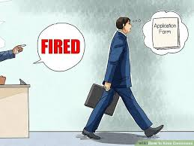
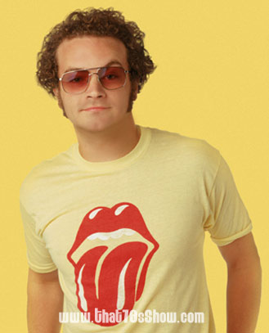
Sangfroid (n.)
composure
coolness in
trying circumstances
poise
self-assurance
---------------------
hysteria

Slide 12
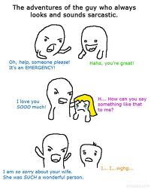
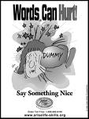
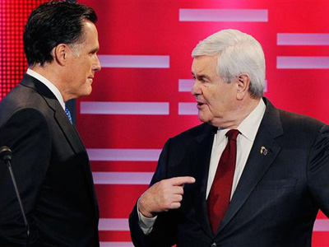
Vitriolic (adj.)
bitter
sarcastic
-------------------------
honeyed
sugary

Slide 13
Wheedle (v.)
to use coaxing or flattery to gain some desired end
sweet-talk
----------------------------
coerce
intimidate

